Slide 1

Git and GitHub In-depth

Slide 2
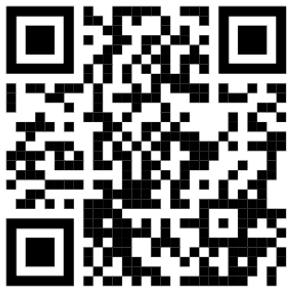
Git and GitHub In-depth
Instructor: Brandon Reyes
Research Computing
Website: www.rc.colorado.edu
Helpdesk: rc-help@colorado.edu
Slides: https://github.com/ResearchComputing/git_github_in_depth_short_course
Survey: http://tinyurl.com/curc-survey18

Slide 3


Goals
Learning Goals
Convince you that basic Git/GitHub fluency is:
Easy
Practical
An extremely important tool in your tool belt!
Learn basic Git and GitHub fluency
Creating a repo, add, commit, pull, clone, push
Collaboration in GitHub
Forks, Pull Requests, Issues

Slide 4
Outline
Installing Git and linking GitHub to your Git
Creating your own repository locally
Pushing local changes to GitHub
Collaboration

Slide 5
Disclaimer:
In this presentation, we will assume that you have a basic understanding of version control and have been introduced to Git and GitHub. There is no need to be fluent in Git or GitHub (we will cover the basics).

Slide 6
Getting Git on your local machine
Many systems have Git installed; however, you may need to download it on your local machine:
See https://git-scm.com/book/en/v2/Getting-Started-Installing-Git for more information on installing Git

Slide 7
Linking Git to GitHub
Once downloaded, we can then configure Git with our GitHub username and email via the command line. This allows us to interact with our GitHub more easily.
First, set your username. For example, if my GitHub username is gh-user, then I would do the following:
$ git config --global user.name “gh-user”
Now, set your email. For example, if my email for GitHub is gh-user@gmail.com, then I would do the following:
$ git config --global user.email “gh-user@gmail.com”
Confirm Git has been configured (should show your entered info)
$ git config --list

Slide 8
Personal Access Token
Allows you to verify your identity with GitHub
For more information, see https://docs.github.com/en/authentication/keeping-your-account-and-data-secure/managing-your-personal-access-tokens
Downside is that you need to enter your username and then the Personal Access Token as your password for events such as:
Any interaction with a private repo
Pushing to a public repo
There are ways to store your username and token, but these require third-party software

Slide 9
SSH Keys
Alternative way to verify your identity with GitHub
For more information see: https://docs.github.com/en/authentication/connecting-to-github-with-ssh/generating-a-new-ssh-key-and-adding-it-to-the-ssh-agent
Be sure to select the proper Operating System when using the link
Setup is more involved, but makes it so that you never have to enter your username and token when interacting with a private repo or pushing to a public repo

Slide 10
Getting Started with Git
(local)

Slide 11
Hands on tutorial
Goal: Create a simple project that contains a markdown file
First let’s create a new directory for our project:
$ mkdir git_work
$ cd git_work
$ mkdir git-tutorial
$ cd git-tutotial

Slide 12
Git Repository (Repo)
A Git repository tracks and saves the history of all changes made.
All of this information is stored in “.git”, which is the repository folder
We can make a directory (folder) a Git repo using “git init”

Slide 13
Git Init
In your “git-tutorial” directory run
$ git init
Git creates the "hidden" directory called “.git”
$ ls –a
Your directory is now a repo!
Git is now ready to to be used
Allows us to tell Git what items to watch

Slide 14

Create the main branch
Now that we have a repo, we can create branches. Branches are a version of the repository.
It is customary to name the primary branch “main”
This can be done as follows (after an init)
$ git checkout –b main
You can switch between branches
$ git checkout <branch-name>
Main

Slide 15
Let’s add a file!
It is customary to add a README.md
Description of repo and any helpful information
To add a README.md, in “git-tutorial” create and edit the file using nano (or an editor of your choice)
$ nano README.md
Add anything you would like!
Be sure to save the file when you exit.

Slide 16
Best Practices: Documentation
Include documentation with your project in GitHub so that others (and you) know what your project is and how it should be used.
A README.md (markdown) file can be included in your GitHub project and will display on the front page
What to include in a README:
What your project does
How people can use it
Who you are and how to contact you
License information
Lots of examples and templates available

Slide 17




Git does not know about README.md yet!!

Slide 18
Areas of Git Workflow
Working Area
Items that you are currently working on
Are not tracked by Git!
Exists locally
Staging Area
When Git starts tracking and saving your work
Exists locally
Items are added to this area by using “git add”
Snapshot Area
All staged items are captured
Version of the repo
Exists locally
Items are added to this area by using “git commit”
GitHub
Exists locally and on GitHub!
Items are added to this area using “git push”

Slide 19
Git Status
The git status command displays the state of the working and staging area.
Let’s see what area README.md is in
$ git status
We see it is an untracked file, so it is in the working area

Slide 20
What if you don’t want Git to track something?

Slide 21
.gitignore
We can add a file named “.gitignore” to our repo
Specifies what items (files, directories, etc.) should never be tracked
Let’s create a file to ignore!
$ echo "Super secret stuff" > confidential_data.txt
Add “.gitignore” to “git-tutorial” and put “confidential_data.txt” in it
$ echo confidential_data.txt > .gitignore

Slide 22
Let’s add our files to the staging area now!

Slide 23
Git Add
The git add command adds a change in the working area to the staging area
Let’s add our README.md to the staging area
$ git add README.md
or add everything in the current directory
$ git add .
Anytime a change is made, you need to do a git add (to track them)
Working Area
Staging Area
Snapshot Area
GitHub
git add

Slide 24
Git Commit
The git commit command captures a snapshot of all staged items
Commits can be thought of as a version of the repo
Commits should be accompanied with a brief message
Let’s commit our staged item!
$ git commit -m ‘Create repo, add README.md, add .gitignore’
$ git status
Working Area
Staging Area
Snapshot Area
GitHub
git add
git commit

Slide 25
Common practice – add, commit
git add
Can be performed as much as you want
Doesn’t need to be done after every change
git commit
Always include a comment!!
Bundle common staged items together
Try not to put too many things in a commit

Slide 26
Git Log
The command git log lists the commits made in that repository
Lists the most recent commits first
$ git log

Slide 27
All changes and files are only locally stored right now!

Slide 28
To GitHub we go!

Slide 29
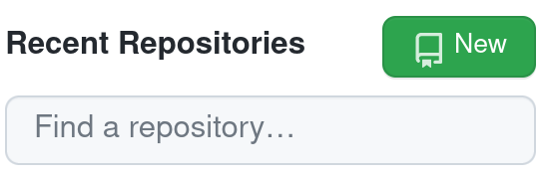
GitHub
When you first create a repo locally, you will need to setup a new repository on GitHub too
Go to https://github.com
Sign in
Click on “Create New Repository” or just “New”

Slide 30
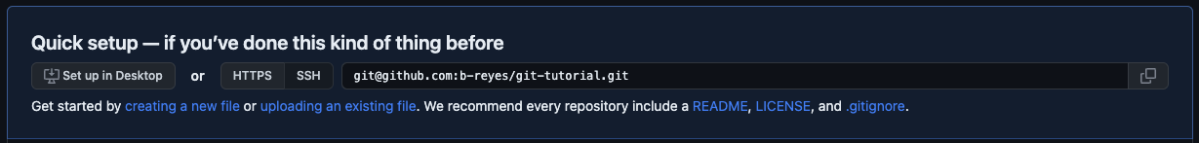
Create Repo in GitHub
Name your repo, I chose “git-tutorial”
Don’t add a README or a .gitignore
Click “Create repository”
We have set everything up in the previous slides, we only need to copy the ssh link!

Slide 31
Linking local repo to GitHub repo

Slide 32
Git Remote
Used to identify the remote (e.g. GitHub) repos are linked to your local repo
Used to link remote repos to your local repo
To view currently linked remote repos:
$ git remote -v
To link our remote repository:
When using an SSH key do:
$ git remote add origin git@github.com:<user>/git-tutorial.git
When using a Personal Access Token do:
$ git remote add origin https://github.com/<user>/git-tutorial.git

Slide 33
Sending local changes to GitHub

Slide 34
Git Push
Uploads local repository content to a remote repository
Pushing is how you transfer commits from your local repo to a remote repo
$ git push <name of remote repo> <branch>
$ git push origin main
Working Area
Staging Area
Snapshot Area
GitHub
git add
git commit
git push

Slide 35
GitHub
Go back to GitHub and refresh your page
should see the files we have added (and not the ones we’ve ignored)
Some cool features!
look at our commits
directly edit/commit in the browser
Let’s do that! Let’s something and commit it on GitHub
But now our remote repo is one commit ahead of our local one…

Slide 36
Git Fetch & Merge
Git fetch retrieves the changes from the remote repo
$ git fetch
Git merge combines two branches
$ git merge origin/main
There’s an easier way!

Slide 37
Git Pull
Git pull combines the fetch and merge commands
$ git pull <name of remote repo> <branch>
$ git pull origin main
IMPORTANT!
Make sure no commits have been done on local branch
It is fine to have staged items (git add)
ALWAYS do git pull before any commits!

Slide 38
Advanced topic: Collaboration

Slide 39

GitHub Forks
Pull Request (PR)
Main Branch
Your Main Branch
Central Repo
(upstream)
Your Forked Repo
Fork

Slide 40

GitHub Forks
Improves collaboration
Don’t have to worry about disturbing the upstream repo
Improves transparency through pull requests
Go ahead and Fork my repo:
Go to https://github.com/b-reyes-rc/git-tutorial
Click “Fork” button
Click “Create fork”
Creates your own version of my repo under your GitHub

Slide 41
Git Clone
Git clone makes a clone (or copy) of a remote repo in a new directory, at another location.
$ git clone <url> <optional new name>
Easy way to grab third-party code, or pre-existing code you might need to work on
Cloning when you have SSH keys:
$ cd git_work
$ git clone git@github.com:<user>/git-tutorial.git
Cloning when you are using Personal Access Tokens:
$ cd git_work
$ git clone https://github.com/user>/git-tutorial.git

Slide 42
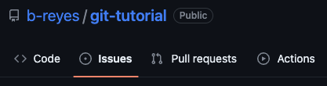
GitHub Issues
Allows you to discuss the project
Point out issues, request features, ask for help
Useful place to see past user discussion

Slide 43
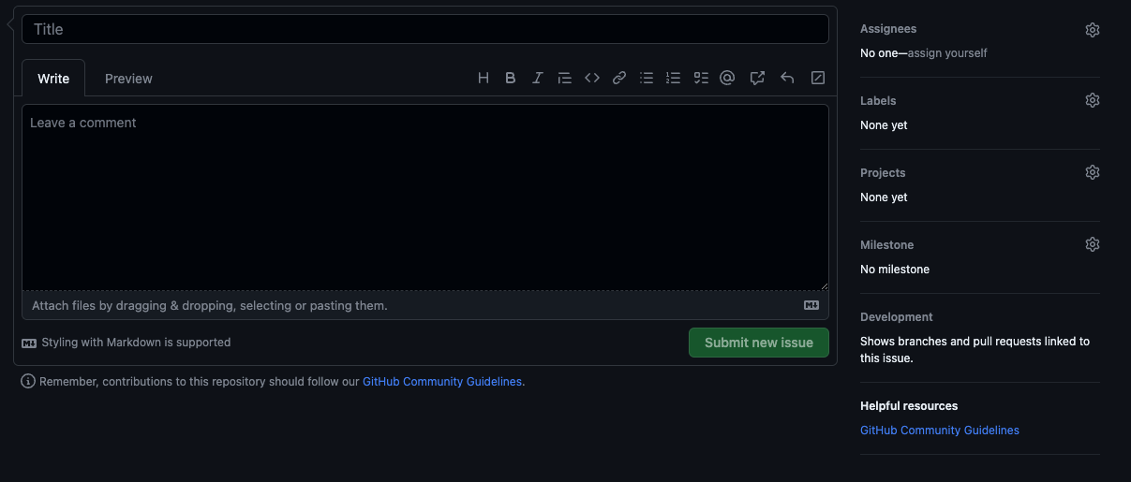
GitHub Issues
Include as much detail as possible
Version of software
Operating system
Provide a simple minimal example, if possible
If a feature request
Outline possible implementation
Highlight its value

Slide 44
Pull Requests (PRs)
A request that an upstream repo pull your branch into their branch
Starting a PR does not automatically merge changes
Notifies maintainers of upstream repo
Allows maintainers to review your changes
Discussion of changes
Requested additional changes
Maintainers of upstream repo merge in the changes

Slide 45
PR steps
Fork upstream repo
Clone the forked repo
Connect forked and cloned repo to upstream repo. Ex. using SSH keys:
Create a new branch specific to your change
Make your changes on this branch
Perform a git add, commit, and push to origin
Create a PR from GitHub
$ git remote add upstream git@github.com:b-reyes-rc/git-tutorial.git
$ git checkout –b <new-branch> <branch-to-copy>

Slide 46
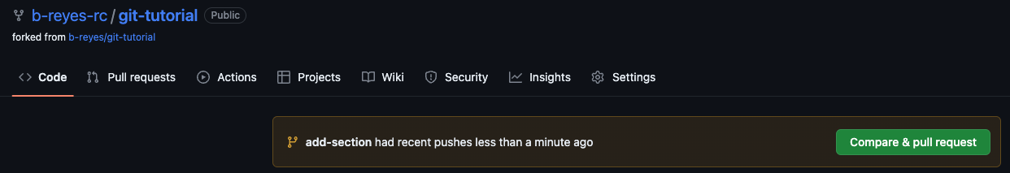
Creating a PR
After you push your changes to the forked repo, you can click the pop-up “Compare & pull request” on GitHub
Will disappear after some time

Slide 47
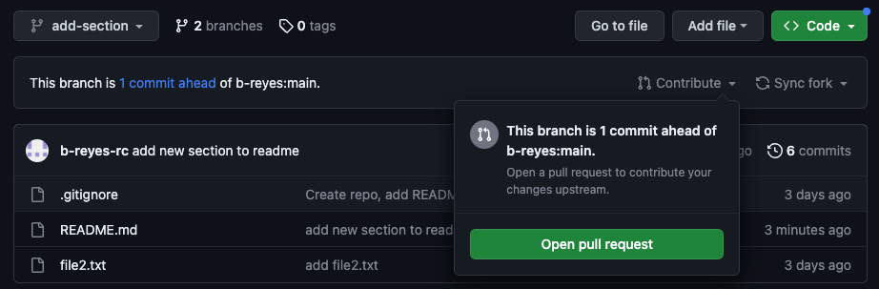
Creating a PR
After you push your changes to the forked repo
Switch to your new branch
Click the drop-down arrow next to “Contribute”
Click “Open pull request”
Will NOT disappear!

Slide 48
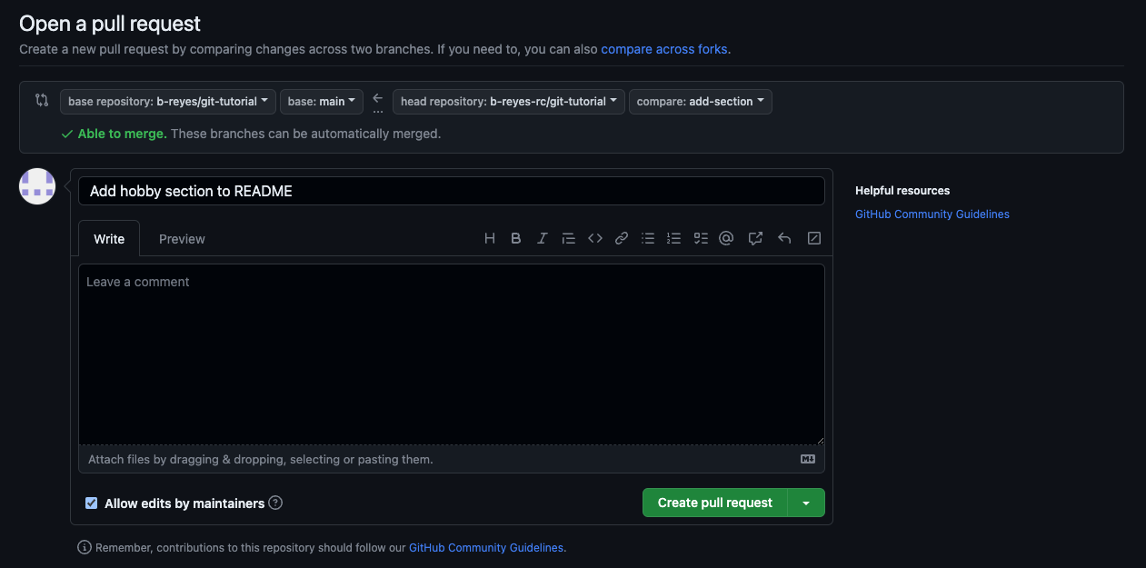
Creating a PR
Our forked repo and branch with our changes
Upstream repo and branch we want to merge into

Slide 49
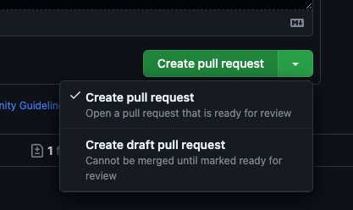
Pull Requests – Best Practice
Create a new feature branch of forked repo
When submitting a PR
Provide a short descriptive title
In comment section
Link to any current issue
Describe what the PR does and reasons for it
Draft pull requests
PR is a work in progress
Can be used for discussion

Slide 50
Merging
When doing a “git pull” you are merging in changes
This process can be done manually
When collaborating, multiple individuals can be working on the same item
Conflicts can happen!
One needs to manually resolve conflicts
Fantastic tutorial on merging:
https://www.atlassian.com/git/tutorials/using-branches/git-merge

Slide 51
Help! I’m stuck, where do I go?
Trainings with Center for Research Data and Digital Scholarship (CRDDS): https://www.colorado.edu/crdds/
Software Carpentries tutorial: https://swcarpentry.github.io/git-novice/index.html
GitHub Student Developer Pack: https://education.github.com/pack
Helpdesk: rc-help@colorado.edu

Slide 52
Survey and feedback
Survey: http://tinyurl.com/curc-survey18
Slides: https://github.com/ResearchComputing/git_github_in_depth_short_course

